Slide 1
3.1 In-Class Activity: Cybersecurity Training and Certification
By: Charles Meredith
CYB 410
05/19/2026

Slide 2

What does ECPI offer you for resources and certification related to your professional goals?
ECPI offers quite a lot of resources to further your professional goals.
One would be the ethical hacking club
Another great resource would get Get-Certified on the vb.ecpi.net domain
You can also join the National Hacking League that ECPI is apart of.

Slide 3

What other training paths or certifications would you be interested in to pursue to further your ethical hacking career?
I am currently taking the hack the box penetration specialist path
This certification is compared to the OSCP because of its hands on nature and difficulty.
I would also like to investigate some Splunk training for SIEM experience.
Another training path that I am on is for the SAL1 certification on Try Hack Me. It basically emulates a real-world scenario you would face as a SOC analyst.
Another good resource is hackthissite.com and acrossthewire.org

Slide 4
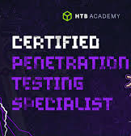
What other certifications would you seek to align with CEH related to your career goals?
I would like to get a few certifications:
OSCP
CPTS from HTB
SAL1 from THM
Splunk Certifications
Cyber Defense Blue team Certifications

Slide 5


Where can someone find more information?
https://www.hackthebox.com/
https://tryhackme.com/
https://cyberdefenders.org/certifications/certified-cyberdefender-level2/
https://ine.com/security/certifications/ejpt-certification

Slide 6
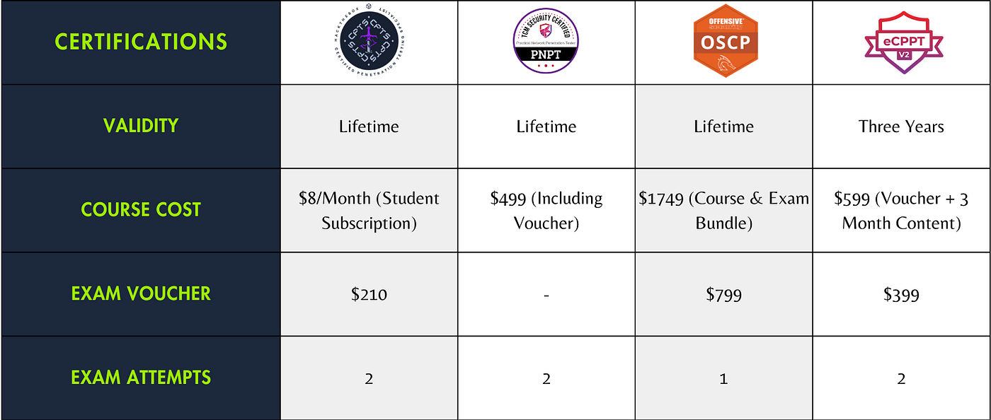
What is the cost involved?
CPTS: $400
OSCP: $ 1700-2700
SAL: $ 350
EJPT certs: $ 250

Slide 7

What are some of the benefits of obtaining the certification or training?
Obtaining certifications allow you to get in the door with HR depending on the certifications you have obtained.
Some certifications that have hands on aspects to them allow for the employer to know that you have concurrent information about how to use those systems.
Another benefit is that you could get higher pay from your employer depending on the certification

Slide 8

What is the expected time frame to complete the certification or training?
The expected time frame depends on the person that is taking the exam, some will progress faster than others.
If you follow certain steps in chronological order taking other exams will be much easier.
For example, if you take the Google Cyber security cert and then take the SAL1 or Junior Penetration Tester from Hack the box you will be more than ready for the Security+ exam which is a DoD basic requisite.
If you work through the CPTS from HTB you will more than likely be able to pass the OSCP just based of difficulty and breadth of knowledge needed.

Slide 9

What level of experience or knowledge is required?
The security + is entry level but a requirement. You could easily study for that exam in 1 to 3 months.
A good time frame of study for the OSCP would be something like a quarter to half a year of study time from no technical experience to passing.
The CPTS would take you a good 4 to 12 months to complete.
A lot of the information or experience required is based on the amount of knowledge that the user has though, some tests require you to have years in the experience such as the CISSP which requires 5 years in the field and a sponsor.

Slide 10
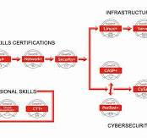
Reference Page
A deep dive on the OSCP Certification aka The Offensive Security Certified Professional. Cybersecurity Guide. (2025, October 17). https://cybersecurityguide.org/programs/cybersecurity-certifications/oscp/

